Slide 1

Live streaming
Student:
Saleh Ahmed Alheeh
University ID:
201614721
Teacher:
Shahanawaj Ahamad
Course:
Internet Protocols & C/S Prog

Slide 2
Outline
Introduction
Definition of live streaming:
The first live stream
Live Streaming evolution
Live Streaming uses
Live Streaming Launches
Live Streaming advantage
Live Streaming disadvantage
Conclusion

Slide 3

Introduction
Live streaming is an easy way to reach your audience in real time. Whether you're streaming a video game, hosting a live Q&A, or teaching a class.
Definition of live streaming:
Live streaming is the act of creating streaming content and broadcasting it live to an audience on the Internet

Slide 4

Introduction
The first live stream :
the first live stream made waves across the internet. In 1993, Xerox PARC was hosting a small show in Palo Alto when engineers who were in another room decided to test their new technology to broadcast on the internet. A band known as “Severe Tire Damage” was playing at the event, and almost by accident, their show became the first ever live streaming event.

Slide 5
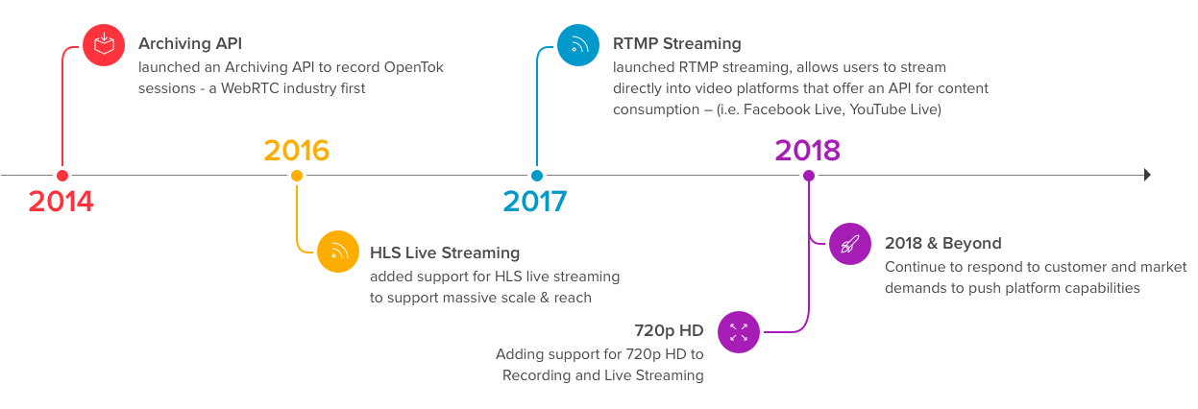
Live Streaming evolution

Slide 6
Live Streaming uses
Many companies use streams to promote products live or showcase events while they happen. Live streams are commonly used by influencers to answer questions from their audience or create video podcasts. Internet live streams are also used to broadcast sports, or other activities which would traditionally be televised, to attract the attention of Internet users.
The uses of the live streaming are many, such as :
Educational
Social Media
Games
Channels

Slide 7
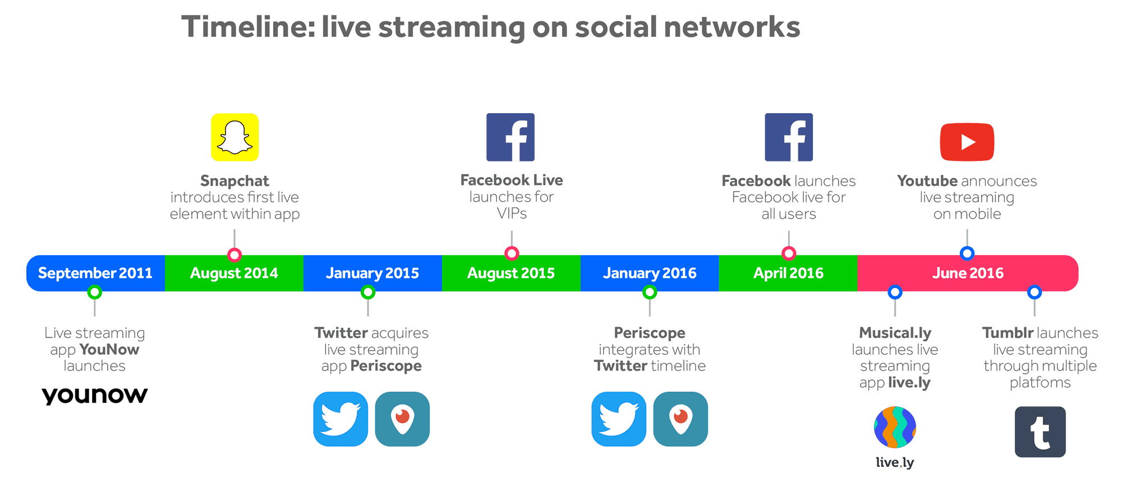
Live Streaming Launches

Slide 8
Live Streaming advantage
We cannot limit the advantage of the live streaming feature if it is used correctly
Some of The advantage of the live streaming are :
Wider Audience Potential
Ease and Convenience
Customer Support
Supports all Devices

Slide 9
Live Streaming disadvantage
With the launch of the live streaming feature, many professionals expressed their fear of this feature in the event of misuse, which made their beliefs a reality as once this feature spread, many users expressed their dissatisfaction with the inability of the management of these applications to block obscene words that some use in Their live broadcasts and the actual inability to manage and monitor content.

Slide 10
Conclusion
Live streaming is the latest social media offering that is rapidly growing in popularity on major platforms like Facebook and Twitter. It contains many benefits for companies, education, marketing and communication between users,Some of them were mentioned in the presentation
Any question

